Slide 1

Customer Review Analysis

Slide 2

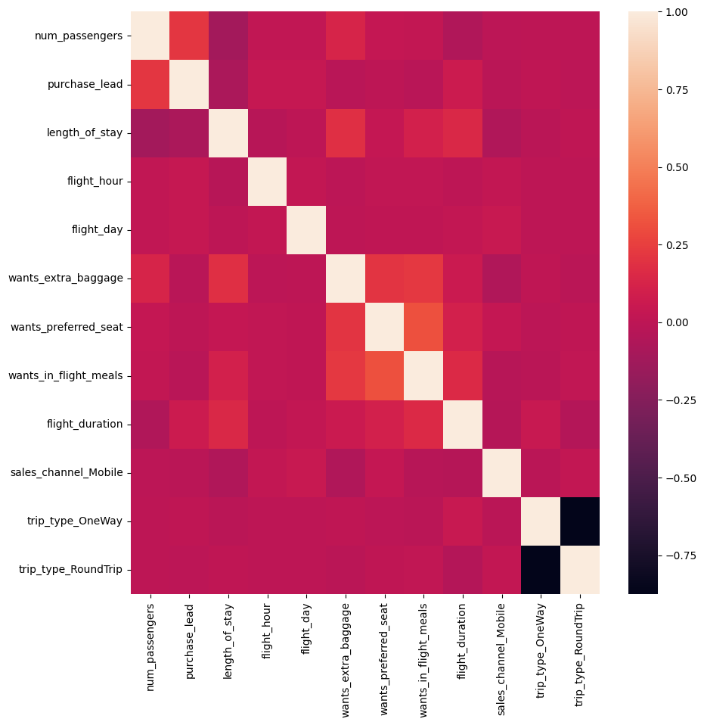
Task 2: Predicting customer buying behaviour
Accuracy measures the proportion of correctly classified instances out of the total instances in a dataset.
The initial dataset was highly imbalanced causing the model to overfit. SMOTE has been used to compensate for the imbalance.
The Random Forest Classifier performs relatively good in binary classification.
The Correlation Matrix shows the importance of every feature to the dataset
Accuracy – 86%

